Slide 1
INTERSHIP STUDIO
ETHICAL HACKING INTERNSHIP
TASK 1
AISWARYA UNNIKRISHNAN
uaiswarya769@gmail.com

Slide 2
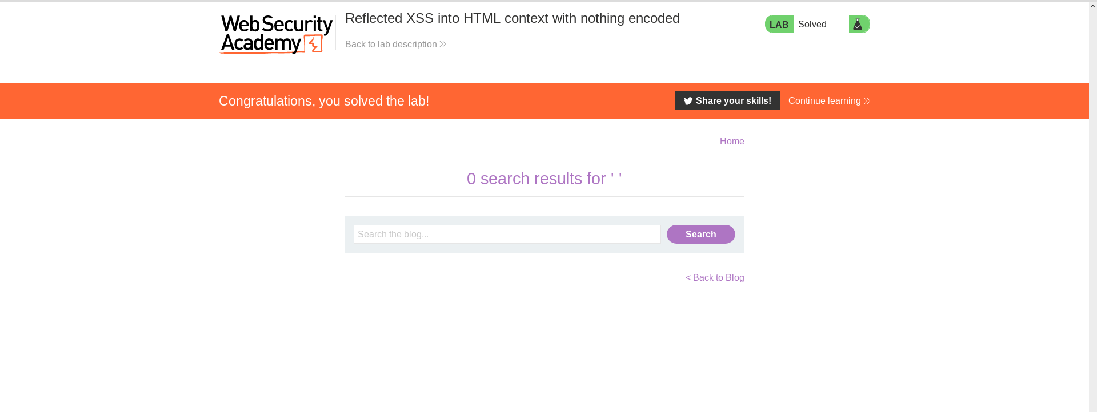

Slide 3
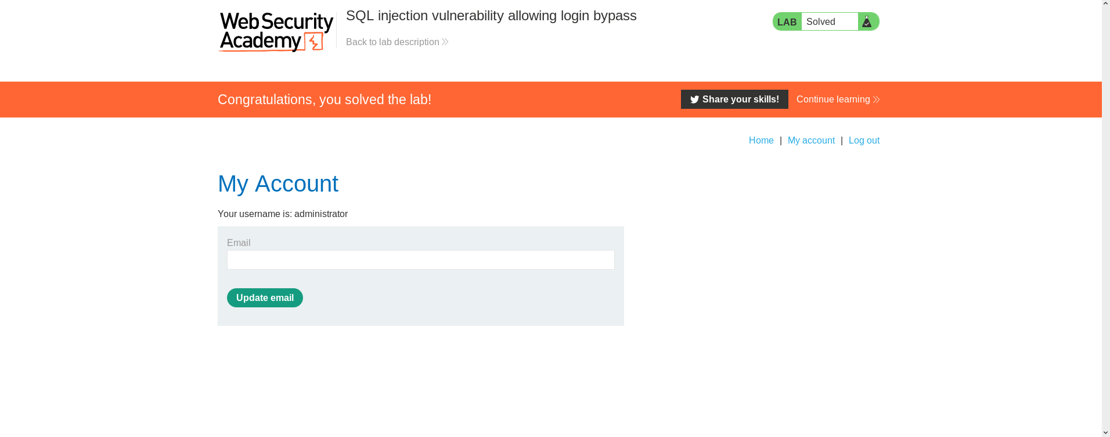

Slide 4
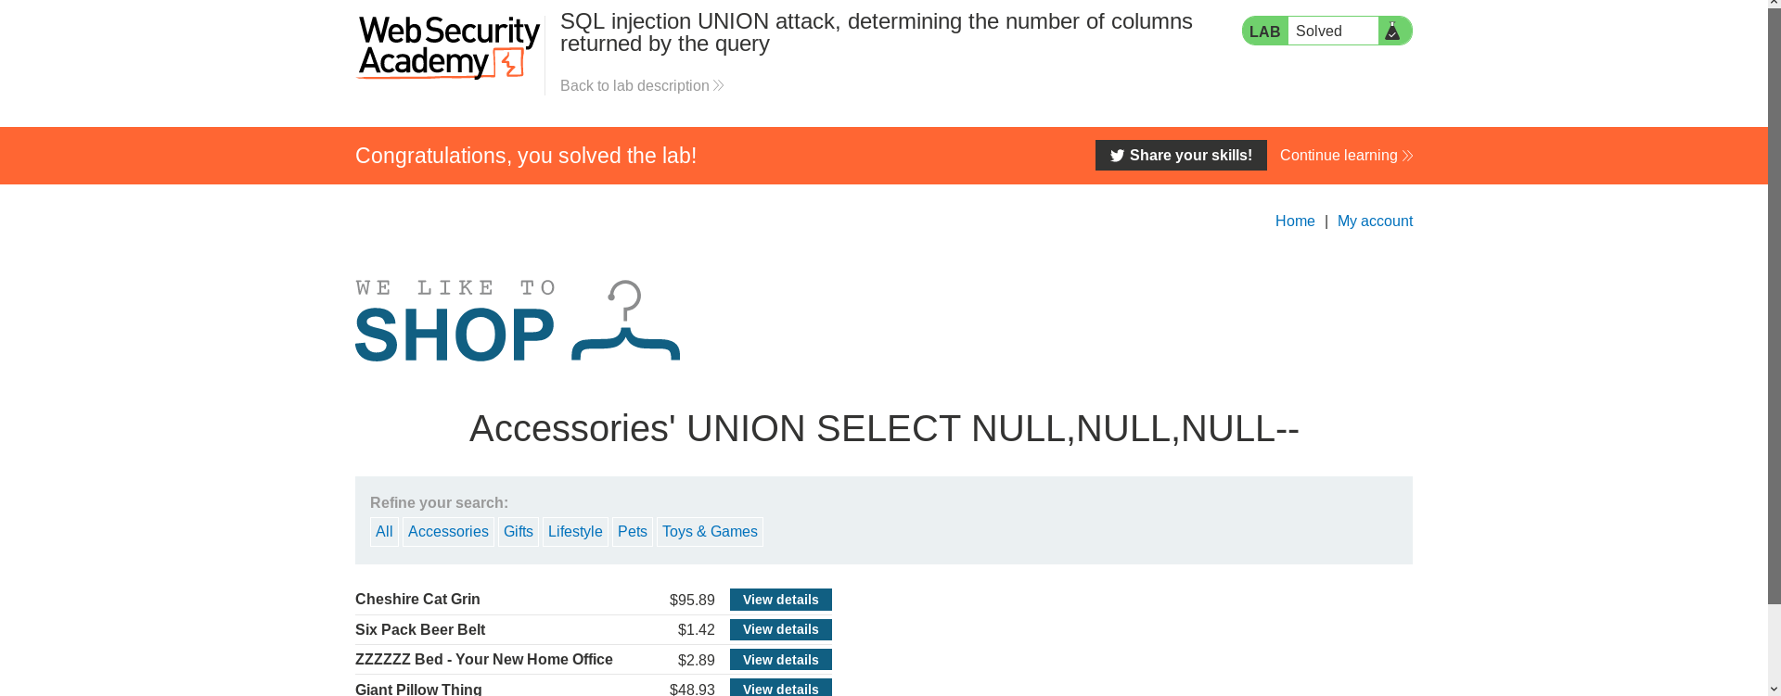

Slide 5
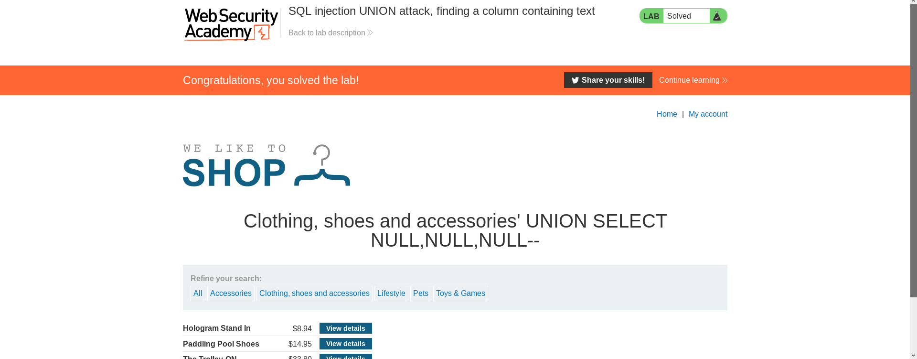

Slide 6
